Slide 1
Analysis of aircraft-bird collisions
2000 - 2011
Year wise strikes and cost trends | impact to aircraft and safety warnings | top airlines and airports with highest collisions | phases of flight at most risk | insights

Slide 2
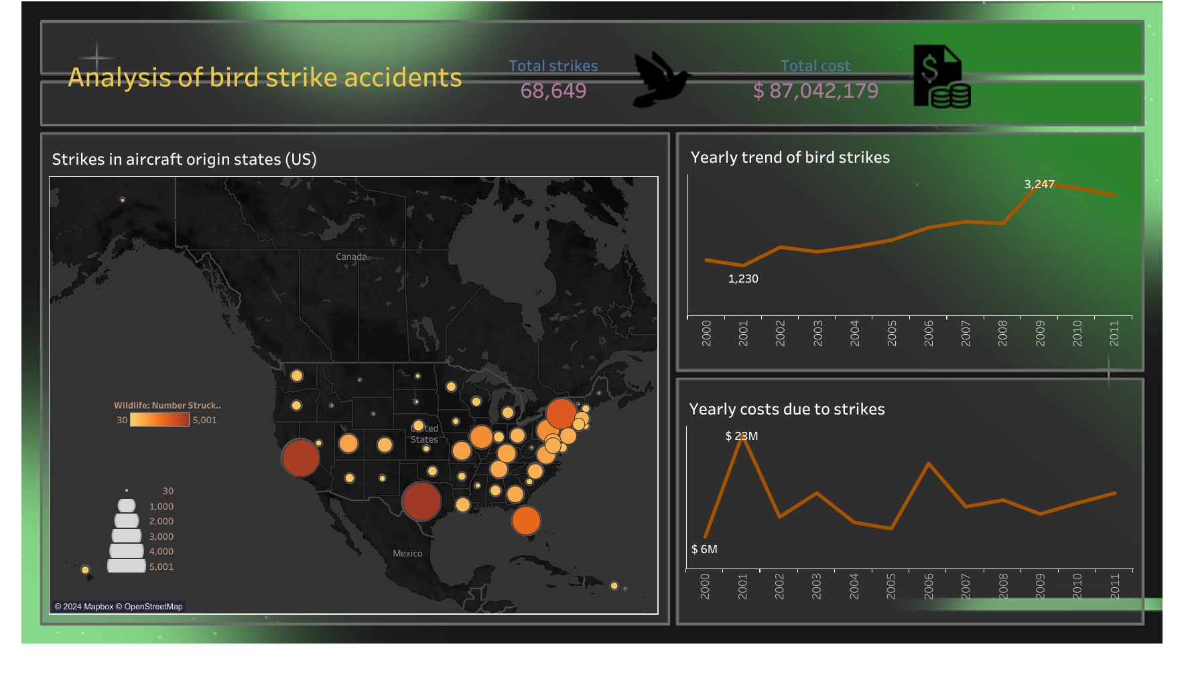

Slide 3
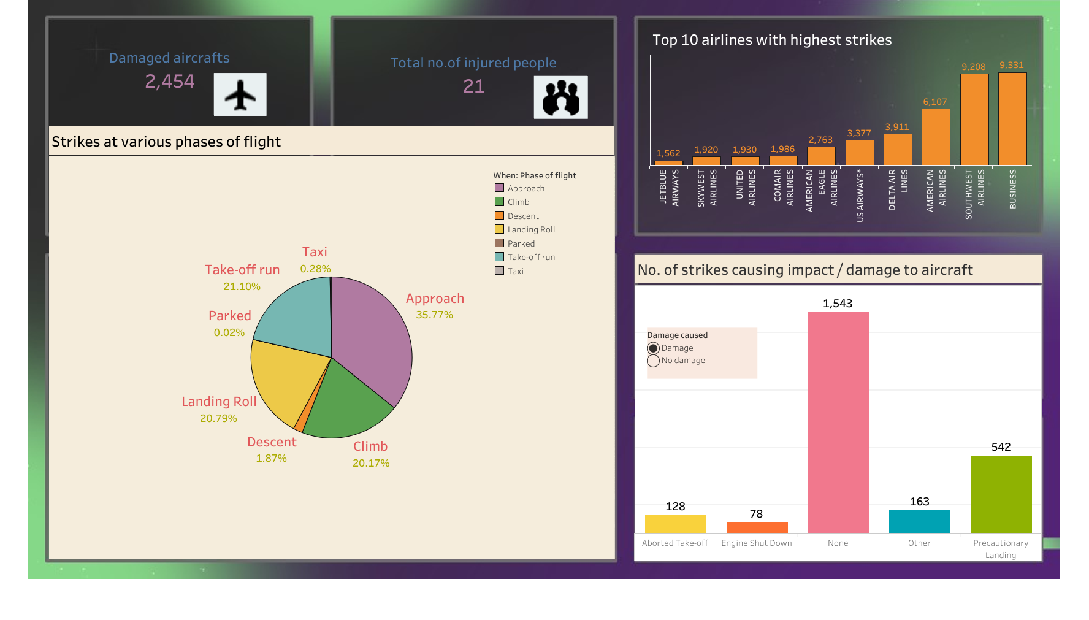

Slide 4
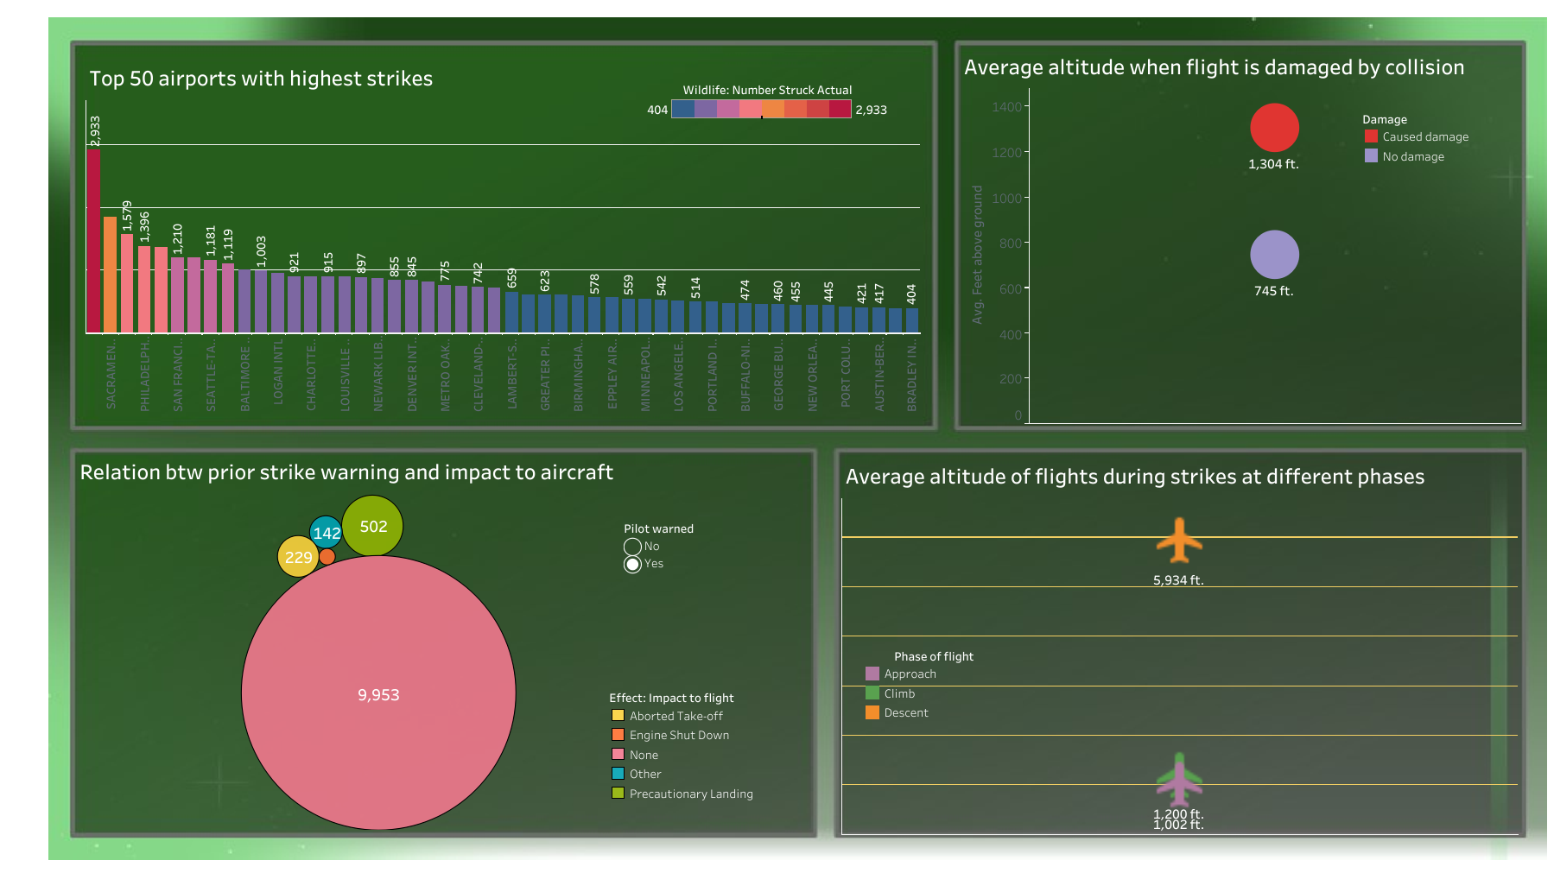

Slide 5
Key Insights
Maximum strike occurred in 2009 but the highest cost was incurred around 2001.
Flights departing from Mexico have the most no. of collisions and Business airlines has the maximum strikes.
Most strikes occur during the ascent/approach phase.
Despite damages, most flights are not effected in their protocols while many undertake a precautionary landing.
Due to prior warnings issued to pilots, no significant impacts on aircrafts are recorded in majority of such flights.
The flight altitude on an average is higher during collisions causing damage than when no damage is recorded.
Incidents of injuries remain low.

Slide 6
Thank You

